Slide 1

Shop Swiftly
By Amir Maharjan

Slide 2

Table of content
Chapter 1: Introduction
Chapter 2: Background study and Literature review
Chapter 3: System Analysis and Design
Chapter 4: Implementation and Testing
Chapter 5: Conclusion
References

Slide 3
Chapter 1: Introduction 1.1 Introduction Of Project
This project was developed in response to the growing demand for customized websites equipped with its own CMS.
This project is a new eCommerce platform with a unique CMS that allows efficient management of all website content.
Administrators can easily view products, prices, images, categories, and pages directly from the CMS interface.

Slide 4
1.2 Problem Statement
Dependency on third-party applications
Performance overhead
Security risks
User Interface

Slide 5
1.3 Objectives
To create an attractive CMS
To create an environment where admin can easily create, manage and organize their contents.
To create a system that will allow users to compare two products

Slide 6
1.4 Scope And Limitation
Scope
People with minimum knowledge about website can also use this website.
Can become similar to amazon
User-friendly interface for booking.
Limitation
Relies on internet connectivity for real-time tracking and updates.
Initial implementation and training may require time and resources.

Slide 7
Chapter 2: Background Study & Literature Review 2.1 Background Study
WordPress: It has been in operation for over 20 years. Almost 43% of all websites have been made using WordPress. I studied this to understand how data flows from one component to another and tried to do the same.
Shopify: This is an e-commerce platform much similar to our own. This platform is built for businesses that want to create online stores.
Joomla: It is one of the most well-known CMS in the world. It has been in operation for almost 20 years. It can be pretty complex especially if someone is used to WordPress

Slide 8
2.2 Literature Review
In Metronic, the system was built using 9 backend languages like Laravel and Node. As for frontend languages, HTML, react, angular, etc.
In Veuxy, the system was built using Laravel, Dot Net core, etc. and Vue 3, Next.Js 14, etc were used for frontend. They provide ultra-responsive design.
In Velzon, users complained about the presence of useless codes, bugs and poor loading pages in AJAX implementation.

Slide 9
Chapter 3: System Analysis And Design 3.1 System Analysis
Waterfall model was used.
Gantt chart was used to track the progress through each phase.
Reviews were conducted at the end of each phase to ensure that ll the expectations were met before proceeding.
A considerable amount of time was spent in the requirement gathering phase.

Slide 10
3.1.1 Requirement Analysis
Functional Requirement
Add to cart
User request to cancel their booking
Light mode / Dark mode
Attractive user interface
Non-Functional Requirement
Reliability
Security
Availability
Performance

Slide 11
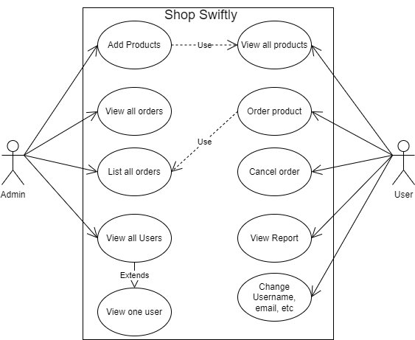
Use Case Diagram

Slide 12
3.1.2 Feasibility Analysis
Technical
Operational
Economic
Schedule

Slide 13
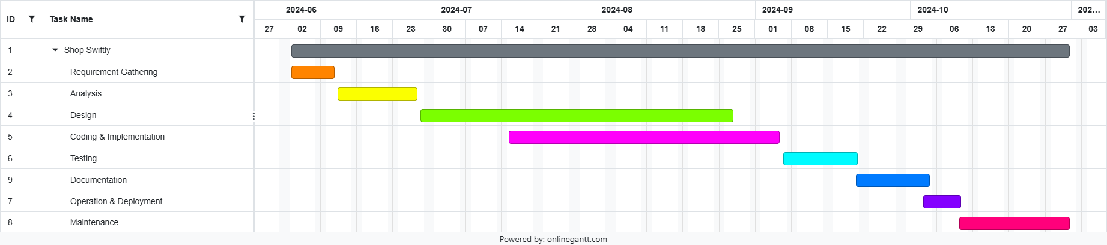
Gantt Chart

Slide 14
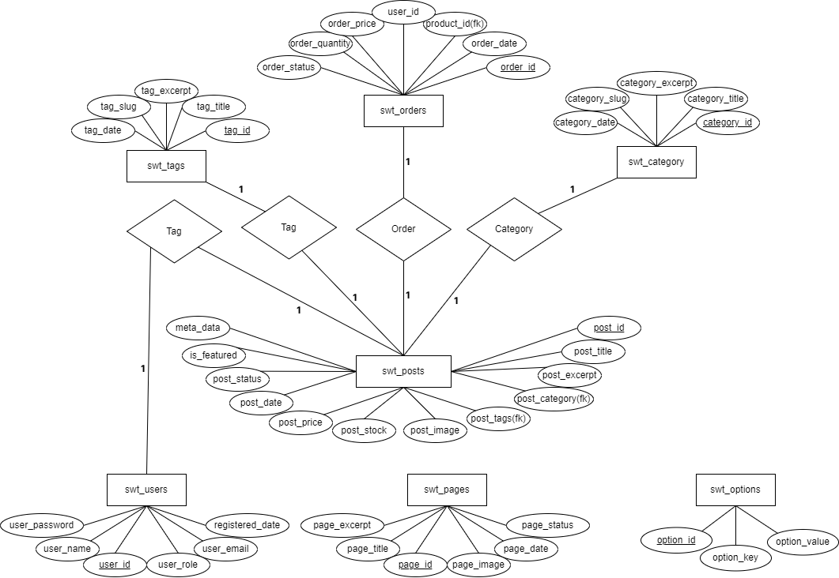
ER Diagram

Slide 15
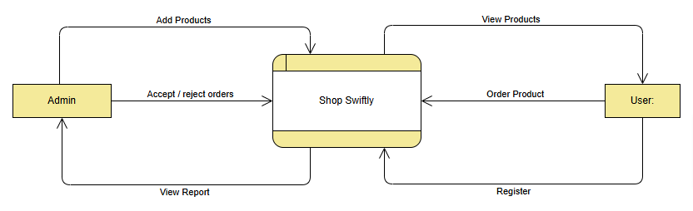
DFD Level 0

Slide 16
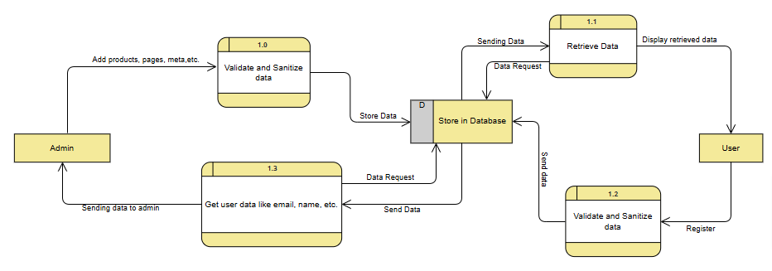
DFD Level 1

Slide 17
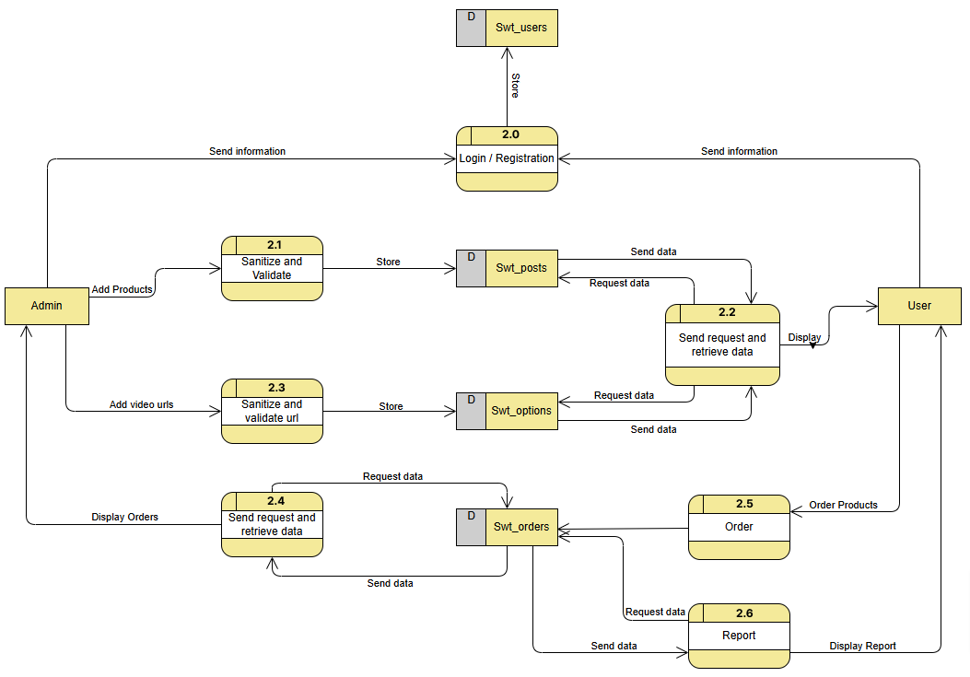
DFD Level 2

Slide 18
3.2 System Design
Design the projects architecture, components and interfaces.
Designed in such a way that it meets all the users requirements.

Slide 19
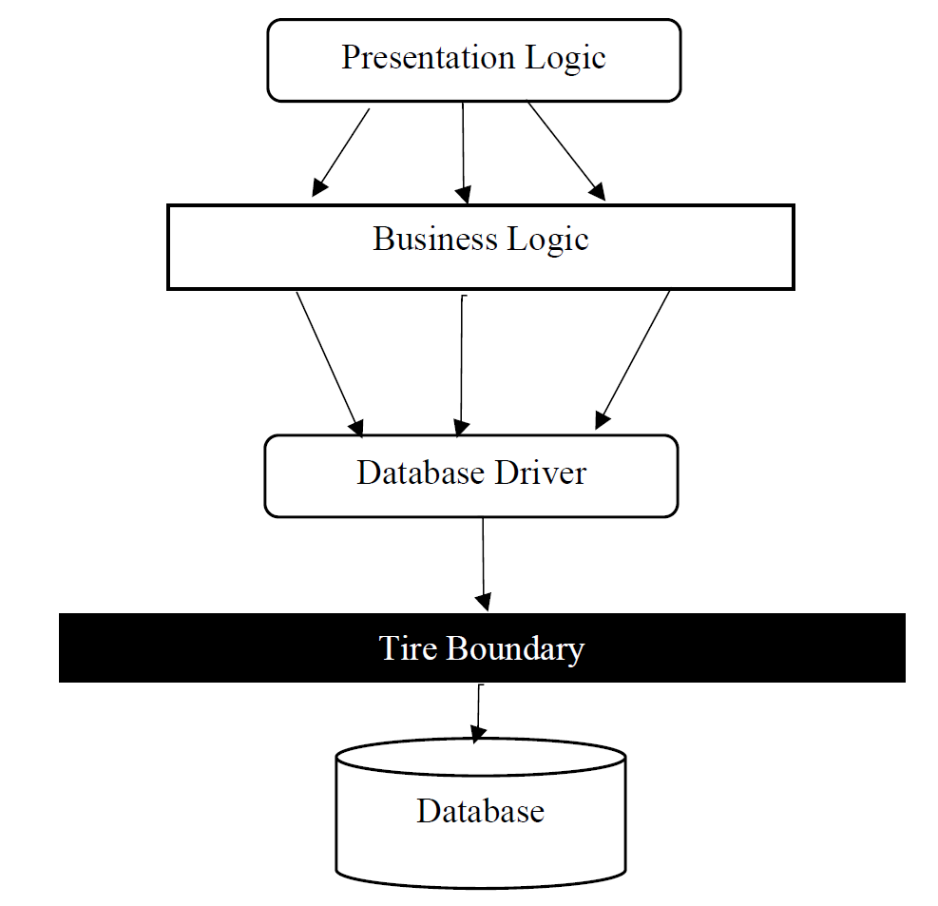
3.2.1 Architectural Design

Slide 20
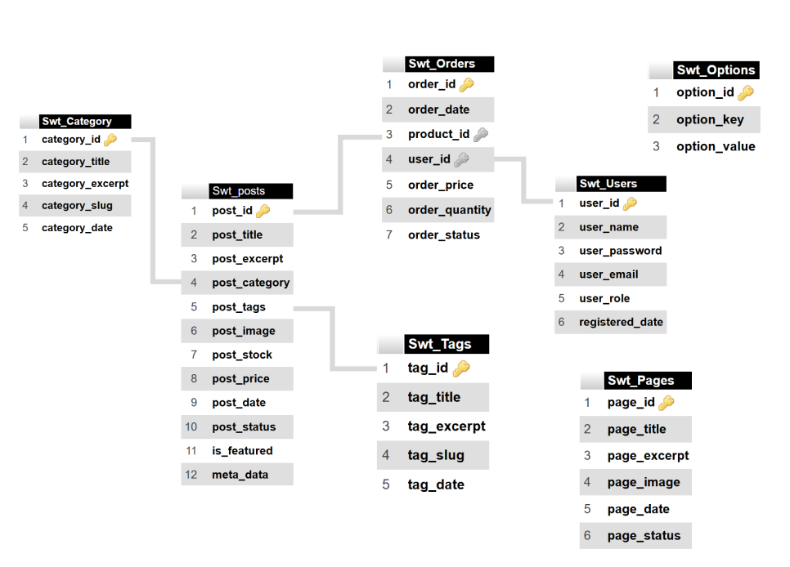
3.2.2 Database Schema

Slide 21
Chapter 4: Implementation & Testing 4.1 Implementation
During the implementation phase, design specifications such as database schema, DFD, interface design were transformed into a functioning software application.
The testing phase begins after the implementation phase has ended. During this phase, codes were tested.
Whether or not the modules were implemented as planned during the system design and analysis phase.

Slide 22
4.1.1 Tools Used
Programming Languages
Frontend
HTML
CSS
React
Backend
PHP
Database Platforms
phpMyAdmin
Libraries Used
Swiper Js
FontAwesome
Chart Js

Slide 23
4.1.2 Algorithms
Sorting Algorithm
Pagination Algorithm
Live Search Algorithm

Slide 24
4.1.3 Implementation of Modules
Login

Slide 26
4.2 Testing
Now that the system has been designed, examined, and put into operation, it is time to test it for flaws and faults.
The testing step of the system development process is essential since it reduces errors and aids in system troubleshooting.
Although there are many various kinds of tests that can be done, for the sake of this report, we will mostly concentrate on the system's functionality, performance, and security.

Slide 27
4.2 Testing
4.2.1 Unit Testing
ID | Test Case Description | Test data | Expected Result | Actual Result | Pass / Fail
1 | Wrong username | Username: test@1234 Password: Amir12345 | Username does not exist | As expected | Pass
2 | Wrong password | Username: Amir12345 Password: test@1234 | Password does not match | As expected | Pass
3 | Valid username and password | Username: Amir12345 Password: Amir12345 | Login | As expected | Pass

Slide 28
4.2.1 System Testing
Verify that the password is stored in the database via md5 or password hashing.
Verify that the emails are valid or not by filtering the emails
Verify that for better UI interface and user satisfaction, form fields contain dropdowns, radio buttons, checkboxes, sliders, etc.
Verify that on form submit data are stored in the database properly.
Verify that the session variables are cleared after logout
Verify that all required form fields are filled.

Slide 29
Chapter 5: Conclusion & Future Recommendation
5.1 Lesson Learnt
Learned to work with patience, improved my problem-solving skill and programming logics.
Communicate with users on a regular basis to learn about their needs and requirements.
a project needs to be finished by the specified timeframe.

Slide 30
5.2 Conclusion
A system that would enable users to order their desired products whenever they wanted, from anywhere.
The users can view various products, read about them, see their price information, etc.
The foundation of the application and this project has been accomplished with the targets met.

Slide 31
5.3 Future Recommendation
Adding FAQ section
Adding custom feedback and reviews section
Adding comments section
Allowing users to rate products.

Slide 32
References
R. Themes, "Scholastica," RoseaThemes Pvt Ltd, [Online]. Available: https://roseathemes.com/scholastica/1/my/.
Keenthemes, "Metronic," KeenThemes Pvt. Ltd., [Online]. Available: https://keenthemes.com/metronic/tailwind/demo1/.
Pixinvent, "Veuxy," Pixinvent Pvt. Ltd., [Online]. Available: https://demos.pixinvent.com/vuexy-html-admin-template/html/vertical-menu-template/.

Slide 33
The end

